Slide 1
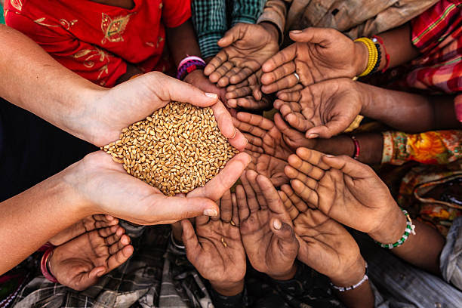
Meal Mission
This is a platform that focuses on zero food wastage This Meal Mission is contributed to helpless people. This mission is mainly focused to deliver unused food to needy people and utilized food properly and our little contribution with this application to make a chain between distributor and taker to deliver the food to the needy people.

Slide 2
Technology used
Frontend Used Technology:
HTML ( Hypertext Markup Language)
CSS (Cascading Styling Sheet)
React JS ( for making dynamic properties & functionalities)
Backend Used Technology:
Python ( support language for software developers, for build control and management, testing, and in many other ways).
Django (Django is a high-level Python web framework that enables rapid development of secure and maintainable websites).
MySQL ( MySQL is a relational database management system. a database system is storing the information so it can be accessed in the future).

Slide 3
Problem Statement
Statement : Zero Food Waste System by developing smart app based system to minimize food wastes in the supermarkets/ restaurants.
Key Outcomes Expected:
Development of smart app to minimise food waste including features like:
A solution that stimulates demand for discounted products with a best before date and to assess the quality of food.
Connecting food donors with hunger relief organizations.
Connecting restaurants that have unsold food with customers looking for discounts.
Waste food to nearby animals shelter and for processing if any.

Slide 4
Whole Working Process
This is mainly divided into two phases :
Distributor : This functionality is mainly used for distribute the food to needy people. Firstly, Signup in the application and fill all the details and then save all the details in the MySQL database.
Taker/Needy people: This functionality is mainly focused on taking the food with the help of this application and enjoy the food.
There are some more functionalities like:
Food details: Veg or Non Veg, Packed or Unpacked.
Packaging details : mainly focused on packed products like Expired Date.

